Slide 1
BLM1612 - Circuit Theory
Prof. Dr. Nizamettin AYDIN
naydin@yildiz.edu.tr
www.yildiz.edu.tr/~naydin
2nd Order Circuits

Slide 2
2nd Order Circuits

Slide 3
Objective of Lecture
Demonstrate how to determine the boundary conditions on the voltages and currents in a 2nd order circuit.
These boundary conditions will be used when calculating the transient response of the circuit.

Slide 4
2nd Order Circuits
A second-order circuit is characterized by a second-order differential equation.
The circuit will contain at least one resistor and the equivalent of two energy storage elements
2 capacitors, 2 inductors, or a capacitor and an inductor

Slide 5
Boundary Conditions
Steady state
For step response functions u(t- t_{o}) for all times between
t = +/- ∞ except for some time period after t = t_{o}
Capacitors are open circuits
Inductors are short circuits
During the transition at the step t = t_{o}
Voltage across a capacitor is continuous
v_{C}(t_{o} ⁺) = v_{C} (t_{o} ⁻)
Current through an inductor is continuous
i_{L}(t_{o} ⁺) = i_{L}(t_{o} ⁻)

Slide 6
Initial Condition
Redraw the circuit at t < t_{o}
Determine the value of all voltage and current sources at t< t_{o}
Make the appropriate substitutions for the energy storage devices.
Substitute an open circuit (∞Ω resistor) for all capacitors.
Note: I_{C}(t < t_{o} ) = 0A.
Substitute an short circuit (0Ω resistor) for all inductors.
Note: V_{L}(t < t_{o} ) = 0V.
Calculate V_{C}(t < t_{o} ) and I_{L}(t < t_{o} ).

Slide 7
Final Condition
Redraw the circuit at t = ∞ s
Determine the value of all voltage and current sources at t = ∞ s
Make the appropriate substitutions for the energy storage devices.
Substitute an open circuit (∞Ω resistor) for all capacitors.
Note: i_{C}(t =∞ s) = 0A.
Substitute an short circuit (0Ω resistor) for all inductors.
Note: v_{L}(t =∞ s) = 0V.
Calculate v_{C}(t =∞ s) and i_{L}(t =∞ s).

Slide 8
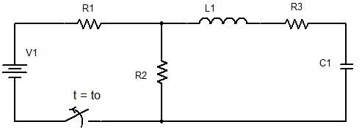
Example 01…
The switch in the circuit has been closed for a long time. It is open at t = t₀.
Find the Boundary Conditions
i_{L}, v_{L}, i_{C}, v_{C}

Slide 9
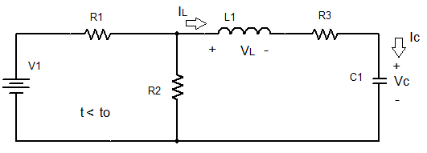
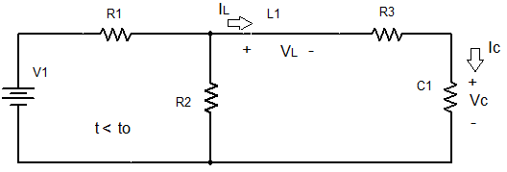
…Example 01…
At the initial condition the circuit is:
i_{L} (-∞) = i_{L} (t_{o}⁻) = 0 A v_{L} (-∞) = v_{L} (t_{o}⁻) = 0 V
i_{C} (-∞) = i_{C} (t_{o}⁻) = 0 A v_{C} (-∞) = v_{C} (t_{o}⁻) = [R₂/(R₁+R₂)]V1
∞Ω

Slide 10
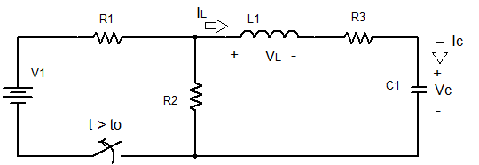
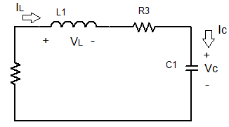
…Example 01…
At the final condition the switch opens,
which removes V1 and R1 from the circuit.
The energy stored in the inductor and capacitor will be dissipated through R2 and R3 as t increased from t = t_{o}.
R2

Slide 11
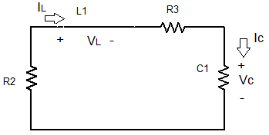
…Example 01
At time t = ∞s, the energy stored in the inductor and in the capacitor will be completely released to the circuit.
i_{L} (∞s) = 0 A v_{L} (∞s) = 0 V i_{C} (∞s) = 0 A v_{C} (∞s) = 0 V
For t_{o} < t << ∞s
i_{L} (t) ≠ 0 A v_{L} (t) ≠ 0 V
i_{C} (t) ≠ 0 A v_{C} (t) ≠ 0 V
∞Ω

Slide 12
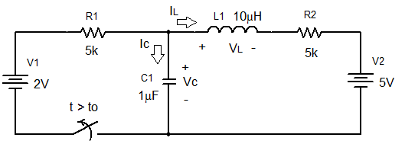
Example 02…
The switch in the circuit has been closed for a long time. It is open at t = t₀.
Find the Boundary Conditions
i_{L}, v_{L}, i_{C}, v_{C}

Slide 13
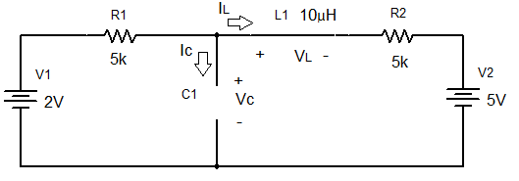
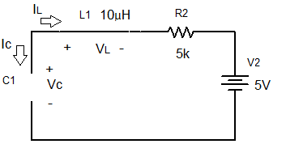
…Example 02
t < t_{o}
t >> t_{o}
i_{L} (-∞s) = 0.3 mA
v_{L} (-∞s) = 0 V
i_{C} (-∞s) = 0 A
v_{C} (-∞s) = 3.5 V
i_{L} (∞s) = 0 A
v_{L} (∞s) = 0 V
i_{C} (∞s) = 0 A
v_{C} (∞s) = 5 V

Slide 14
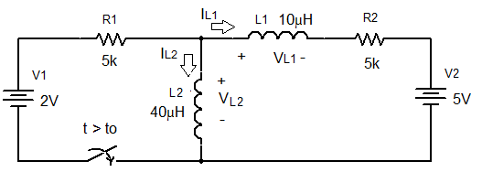
Example 03…
The switch in the circuit has been open for a long time. It is open at t = t₀.
Find the Boundary Conditions
i_{L1}, v_{L1}, i_{L2}, v_{L2}

Slide 15
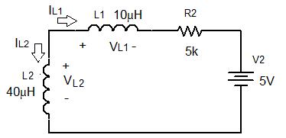
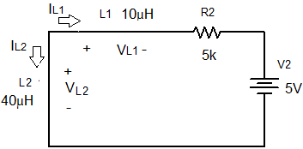
…Example 03…
t < t_{o}
i_{L1} (-∞s) = -1 mA v_{L1} (-∞s) = 0 V
i_{L2} (-∞s) = 1 mA v_{L1} (-∞s) = 0 V

Slide 16
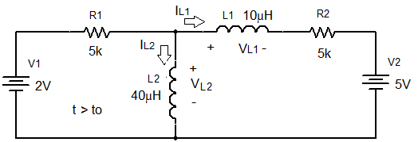
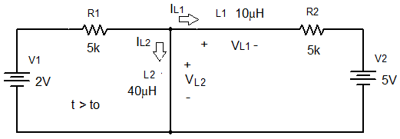
…Example 03
t > t_{o}
t >> t_{o}
i_{L1} (∞s) = -1 mA v_{L1} (∞s) = 0 V
i_{L2} (∞s) = 1.4 mA v_{L2}(∞s) = 0 V

Slide 17
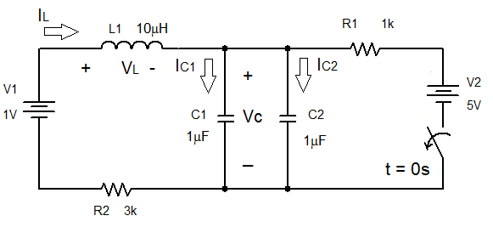
Example 04…
The switch in the circuit has been closed for a long time. It is closed at t = 0.
Find the Boundary Conditions
i_{L}, v_{L}, i_{C1}, v_{C1}, i_{C2}, v_{C2}

Slide 18
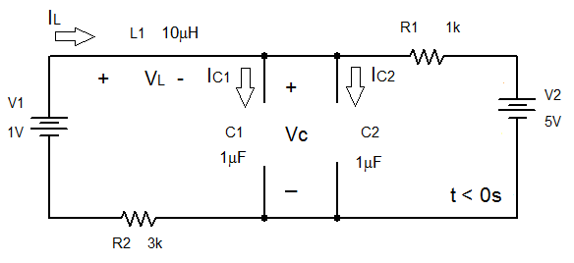
…Example 04…
t < 0
i_{L1} (-∞s) = -1 mA v_{L1} (-∞s) = 0 V
i_{C1} (-∞s) = i_{C2} (-∞s) = 0 A v_{C1} (-∞s) = v_{C2} (-∞s) = 4 V

Slide 19
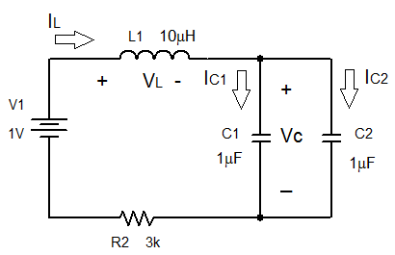
…Example 04
t >> 0
i_{L1} (∞s) = 0mA v_{L1} (∞s) = 0V
v_{C1} (∞s) = v_{C2} (∞s) = 1V i_{C1} (∞s) = i_{C2} (∞s) = 0A

Slide 20
Summary
Calculation of the initial and final conditions for 2nd order circuits requires:
Knowledge of the magnitude of the voltage and/or current sources in the circuit before and after a step function transition.
In steady state (t < t_{o} and t = ∞s), replace energy storage devices.
Capacitors are opens circuits => i_{C} = 0 A
Inductors are short circuits => v_{L} = 0 V
Calculate the voltage across the capacitor and the current through the inductor.
During the transition at the step t = t_{o}
Voltage across a capacitor is continuous
v_{C}(t_{o} ⁺) = v_{C} (t_{o} ⁻)
Current through an inductor is continuous
i_{L}(t_{o} ⁺) = i_{L}(t_{o} ⁻)

Slide 21
Source-Free RLC Circuit-Series RLC Network
Objective of Lecture
Derive the equations that relate the voltages across and currents flowing through a resistor, an inductor, and a capacitor in series as:
the unit step function associated with voltage or current source changes from 1 to 0 or
a switch disconnects a voltage or current source into the circuit.
Describe the solution to the 2nd order equations when the condition is:
Overdamped
Critically Damped
Underdamped

Slide 22
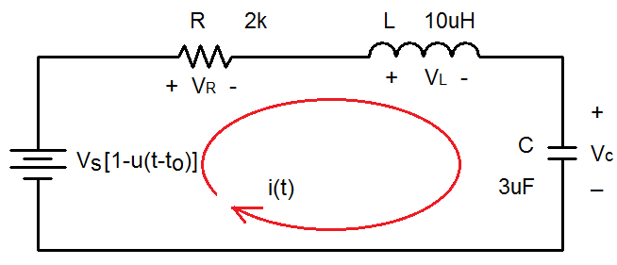
Series RLC Network
With a step function voltage source.

Slide 23
Boundary Conditions
You must determine the initial condition of the inductor and capacitor at t < t_{o} and then find the final conditions at t = ∞s.
Since the voltage source has a magnitude of 0 V at t < t_{o}
i(t_{o}⁻) = i_{L}(t_{o}⁻) = 0 A and v_{C}(t_{o}⁻) = Vs
v_{L}(t_{o}⁻) = 0 V and i_{C}(t_{o}⁻) = 0 A
Once the steady state is reached after the voltage source has a magnitude of Vs at t > t_{o}, replace the capacitor with an open circuit and the inductor with a short circuit.
i(∞s) = i_{L}(∞s) = 0 A and v_{C}(∞s) = 0 V
v_{L}(∞s) = 0 V and i_{C}(∞s) = 0 A

Slide 24
Selection of Parameter
Initial Conditions
i(t_{o}⁻) = i_{L}(t_{o}⁻) = 0 A and v_{C}(t_{o}⁻) = Vs
v_{L}(t_{o}⁻) = 0 V and i_{C}(t_{o}⁻) = 0 A
Final Conditions
i(∞s) = i_{L}(∞s) = 0A and v_{C}(∞s) = 0 V
v_{L}(∞s) = 0 V and i_{C}(∞s) = 0 A
Since the voltage across the capacitor is the only parameter that has a non-zero boundary condition, the first set of solutions will be for v_{C}(t).

Slide 25
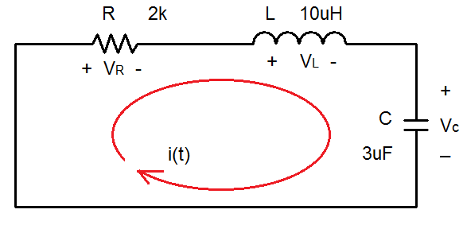
Kirchhoff’s Voltage Law
Second order
Differential Equation

Slide 26
General Solution…
Let v_{C}(t) = Ae^{sΔt}

Slide 27
…General Solution…
Characteristic Equation
Roots of
Characteristic Equation

Slide 28
…General Solution…
A more compact way of expressing the roots:
The roots s₁ and s₂ are called natural frequencies, measured in nepers per second (Np/s),
because they are associated with the natural response of the circuit;
ω₀ is known as the resonant frequency or strictly as the undamped natural frequency, expressed in radians per second (rad/s);
α is the neper frequency or the damping factor, expressed in nepers per second.

Slide 29
….General Solution

Slide 30
Solve for Coefficients A₁ and A₂
Use the boundary conditions at t_{o}⁻ and t = ∞s to solve for A1 and A2.
Since the voltage across a capacitor must be a continuous function of time.
Also know that

Slide 31
Three types of solutions
From these equations, we can infer that there are three types of solutions:
If α > ω₀ , we have the overdamped case.
If α = ω₀ , we have the critically damped case.
If α < ω₀ , we have the underdamped case.
We will consider each of these cases separately.

Slide 32
Three types of solutions
Overdamped Case ( α > ω_{ο} )
implies that C > 4L/R²
s₁ and s₂ are negative and real numbers
Critically damped Case ( α = ω_{ο} )
implies that C = 4L/R²
s₁ = s₂ = - α = -R/2L
v(t)
v(t)

Slide 33
Three types of solutions
Underdamped Case ( α < ω_{ο} )
implies that C < 4L/R²
, i is used by the mathematicians for imaginary numbers
v(t)

Slide 34
Three types of solutions

Slide 35
Angular Frequencies
ω_{o} is called the undamped natural frequency
The frequency at which the energy stored in the capacitor flows to the inductor and then flows back to the capacitor.
If R = 0Ω, this will occur forever.
ω_{d} is called the damped natural frequency
Since the resistance of R is not usually equal to zero, some energy will be dissipated through the resistor as energy is transferred between the inductor and capacitor.
α determined the rate of the damping response.

Slide 36
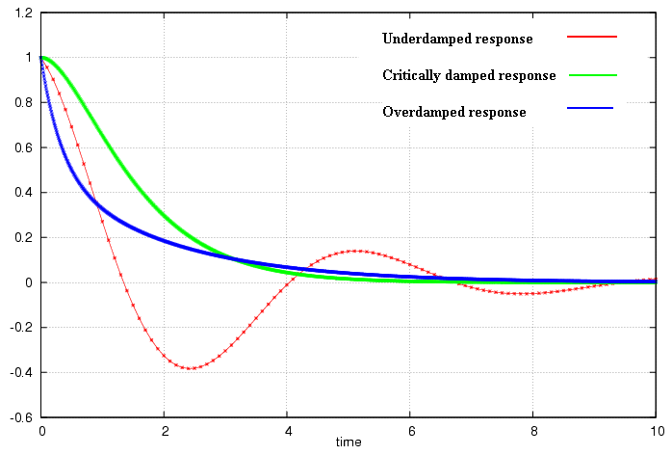
Three types of solutions

Slide 37
Properties of RLC network
Behavior of RLC network is described as damping, which is a gradual loss of the initial stored energy
The resistor R causes the loss
α determined the rate of the damping response
If R = 0, the circuit is loss-less and energy is shifted back and forth between the inductor and capacitor forever at the natural frequency.

Slide 38
Properties of RLC network
Oscillatory response of a lossy RLC network is possible because the energy in the inductor and capacitor can be transferred from one component to the other.
Underdamped response is a damped oscillation, which is called ringing.
Critically damped circuits reach the final steady state in the shortest amount of time as compared to overdamped and underdamped circuits.
However, the initial change of an overdamped or underdamped circuit may be greater than that obtained using a critically damped circuit.

Slide 39
Set of Solutions when t > t_{o}
There are three different solutions which depend on the magnitudes of the coefficients of the and the terms.
To determine which one to use, you need to calculate the natural angular frequency of the series RLC network and the term α.

Slide 40
Transient Solutions when t > t_{o}
Overdamped response (α > ω_{o})
Critically damped response (α = ω_{o})
Underdamped response (α < ω_{o})

Slide 41
Find Coefficients
After you have selected the form for the solution based upon the values of ω_{o} and α
Solve for the coefficients in the equation by evaluating the equation at t = t_{o}⁻ and t = ∞s using the initial and final boundary conditions for the voltage across the capacitor.
v_{C}(t_{o}⁻) = Vs
v_{C}(∞s) = 0 V

Slide 42
Other Voltages and Currents
Once the voltage across the capacitor is known, the following equations for the case where t > t_{o} can be used to find:

Slide 43
Solutions when t < t_{o}
The initial conditions of all of the components are the solutions for all times -∞s < t < t_{o}.
v_{C}(t) = Vs
i_{C}(t) = 0 A
v_{L}(t) = 0 V
i_{L}(t) = 0 A
v_{R}(t) = 0 V
i_{R}(t) = 0 A

Slide 44
Summary
The set of solutions when t > t_{o} for the voltage across the capacitor in a RLC network in series was obtained.
Selection of equations is determine by comparing the natural frequency ω_{o} to α.
Coefficients are found by evaluating the equation and its first derivation at t = t_{o}⁻ and t = ∞s.
The voltage across the capacitor is equal to the initial condition when t < t_{o}
Using the relationships between current and voltage, the current through the capacitor and the voltages and currents for the inductor and resistor can be calculated.

Slide 45
Source-Free RLC Circuit-Parallel RLC Network
Objective of Lecture
Derive the equations that relate the voltages across and currents flowing through a resistor, an inductor, and a capacitor in parallel as:
the unit step function associated with voltage or current source changes from 1 to 0 or
a switch disconnects a voltage or current source into the circuit.
Describe the solution to the 2nd order equations when the condition is:
Overdamped
Critically Damped
Underdamped

Slide 46
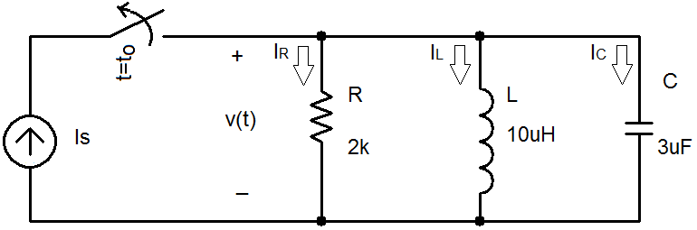
RLC Network
A parallel RLC network where the current source is switched out of the circuit at t = t_{o}.

Slide 47
Boundary Conditions
You must determine the initial condition of the inductor and capacitor at t < t_{o} and then find the final conditions at t = ∞s.
Since the voltage source has a magnitude of 0V at t < t_{o}
i_{L}(t_{o}⁻) = Is and v(t_{o}⁻) = v_{C}(t_{o}⁻) = 0 V
v_{L}(t_{o}⁻) = 0V and i_{C}(t_{o}⁻) = 0 A
Once the steady state is reached after the voltage source has a magnitude of Vs at t > t_{o}, replace the capacitor with an open circuit and the inductor with a short circuit.
i_{L}(∞s) = 0A and v(∞s) = v_{C}(∞s) = 0 V
v_{L}(∞s) = 0V and i_{C}(∞s) = 0 A

Slide 48
Selection of Parameter
Initial Conditions
i_{L}(t_{o}⁻) = Is and v(t_{o}⁻) = v_{C}(t_{o}⁻) = 0 V
v_{L}(t_{o}⁻) = 0V and i_{C}(t_{o}⁻) = 0 A
Final Conditions
i_{L}(∞s) = 0A and v(∞s) = v_{C}(∞s) = 0 V
v_{L}(∞s) = 0V and i_{C}(∞s) = 0 A
Since the current through the inductor is the only parameter that has a non-zero boundary condition, the first set of solutions will be for i_{L}(t).

Slide 49
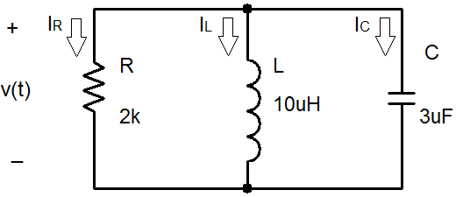
Kirchoff’s Current Law

Slide 50
General Solution

Slide 51
Note that the equation for the natural frequency of the RLC circuit is the same whether the components are in series or in parallel.

Slide 52
Three types of solutions
Overdamped Case (α > ω_{ο} )
implies that L > 4R²C
s₁ and s₂ are negative and real numbers

Slide 53
Three types of solutions
Critically Damped Case ( α = ω_{ο} )
implies that L = 4R²C
s₁ = s₂ = - α = -1/2RC

Slide 54
Three types of solutions
Underdamped Case ( α < ω_{ο} )
implies that L < 4R²C

Slide 55
Other Voltages and Currents
Once current through the inductor is known:

Slide 56
Summary
The set of solutions when t > t_{o} for the current through the inductor in a RLC network in parallel was obtained.
Selection of equations is determine by comparing the natural frequency ω_{o} to α.
Coefficients are found by evaluating the equation and its first derivation at t = t_{o}⁻ and t = ∞s.
The current through the inductor is equal to the initial condition when t < t_{o}
Using the relationships between current and voltage, the voltage across the inductor and the voltages and currents for the capacitor and resistor can be calculated.

Slide 57
Summary of Relevant Equations for Source-Free RLC Circuits

Slide 58
Step Response-Series RLC Network
Objective of Lecture
Derive the equations that relate the voltages across a resistor, an inductor, and a capacitor in series as:
the unit step function associated with voltage or current source changes from 0 to 1 or
a switch connects a voltage or current source into the circuit.
Describe the solution to the 2nd order equations when the condition is:
Overdamped
Critically Damped
Underdamped

Slide 59
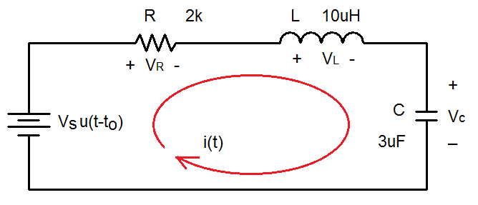
Series RLC Network
With a step function voltage source.

Slide 60
Boundary Conditions
You must determine the initial condition of the inductor and capacitor at t < t_{o} and then find the final conditions at t = ∞s.
Since the voltage source has a magnitude of 0V at t< t_{o}
i(t_{o}⁻) = i_{L}(t_{o}⁻) = 0 A and v_{C}(t_{o}⁻) = 0 V
v_{L}(t_{o}⁻) = 0 V and i_{C}(t_{o}⁻) = 0 A
Once the steady state is reached after the voltage source has a magnitude of Vs at t > t_{o}, replace the capacitor with an open circuit and the inductor with a short circuit.
i(∞s) = i_{L}(∞s) = 0 A and v_{C}(∞s) = Vs
v_{L}(∞s) = 0 V and i_{C}(∞s) = 0 A

Slide 61
Selection of Parameter
Initial Conditions
i(t_{o}⁻) = i_{L}(t_{o}⁻) = 0 A and v_{C}(t_{o}⁻) = 0 V
v_{L}(t_{o}⁻) = 0 V and i_{C}(t_{o}⁻) = 0 A
Final Conditions
i(∞s) = i_{L}(∞s) = 0 A and v_{C}(∞s) = Vs
v_{L}(∞s) = 0 V and i_{C}(∞s) = 0 A
Since the voltage across the capacitor is the only parameter that has a non-zero boundary condition, the first set of solutions will be for v_{C}(t).

Slide 62
Kirchhoff’s Voltage Law

Slide 63
Set of Solutions when t > t_{o}
Similar to the solutions for the natural response, there are three different solutions.
To determine which one to use, you need to calculate the natural angular frequency of the series RLC network and the term α.

Slide 64
Transient Solutions when t > t_{o}
Overdamped response (α > ω_{o})
where t-t_{o} = Δt
Critically damped response (α = ω_{o})
Underdamped response (α < ω_{o})

Slide 65
Steady State Solutions when t > t_{o}
The final condition of the voltages across the capacitor is the steady state solution.
v_{C}(∞s) = Vs

Slide 66
Complete Solution when t > t_{o}
Overdamped response
Critically damped response
Underdamped response

Slide 67
Other Voltages and Currents
Once the voltage across the capacitor is known, the following equations for the case where t > t_{o} can be used to find:

Slide 68
Summary
The set of solutions when t > t_{o} for the voltage across the capacitor in a RLC network in series was obtained.
The final condition for the voltage across the capacitor is the steady state solution.
Selection of equations is determine by comparing the natural frequency ω_{o} to α.
Coefficients are found by evaluating the equation and its first derivation at t = t_{o}⁻ and t = ∞s.
The voltage across the capacitor is equal to the initial condition when t < t_{o}
Using the relationships between current and voltage, the current through the capacitor and the voltages and currents for the inductor and resistor can be calculated.

Slide 69
Step Response-Parallel RLC Network
Objective of Lecture
Derive the equations that relate the voltages across a resistor, an inductor, and a capacitor in parallel as:
the unit step function associated with voltage or current source changes from 0 to 1 or
a switch connects a voltage or current source into the circuit.
Describe the solution to the 2nd order equations when the condition is:
Overdamped
Critically Damped
Underdamped

Slide 70
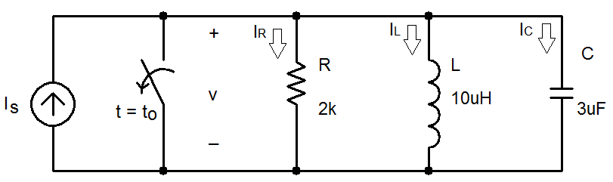
Parallel RLC Network
With a current source switched into the circuit at t= t_{o}.

Slide 71
Boundary Conditions
You must determine the initial condition of the inductor and capacitor at t < t_{o} and then find the final conditions at t = ∞s.
Since the voltage source has a magnitude of 0V at t< t_{o}
i_{L}(t_{o}⁻) = 0 A and v(t_{o}⁻) = v_{C}(t_{o}⁻) = 0 V
v_{L}(t_{o}⁻) = 0 V and i_{C}(t_{o}⁻) = 0 A
Once the steady state is reached after the voltage source has a magnitude of Vs at t > t_{o}, replace the capacitor with an open circuit and the inductor with a short circuit.
i_{L}(∞s) = Is and v(∞s) = v_{C}(∞s) = 0 V
v_{L}(∞s) = 0 V and i_{C}(∞s) = 0 A

Slide 72
Selection of Parameter
Initial Conditions
i_{L}(t_{o}⁻) = 0 A and v(t_{o}⁻) = v_{C}(t_{o}⁻) = 0 V
v_{L}(t_{o}⁻) = 0 V and i_{C}(t_{o}⁻) = 0 A
Final Conditions
i_{L}(∞s) = Is and v(∞s) = v_{C}(∞s) = 0 V
v_{L}(∞s) = 0 V and i_{C}(∞s) = 0 A
Since the current through the inductor is the only parameter that has a non-zero boundary condition, the first set of solutions will be for i_{L}(t).

Slide 73
Kirchhoff’s Current Law

Slide 74
Set of Solutions when t > t_{o}
Similar to the solutions for the natural response, there are three different solutions.
To determine which one to use, you need to calculate the natural angular frequency of the parallel RLC network and the term α.

Slide 75
Transient Solutions when t > t_{o}
Overdamped response
Critically damped response
Underdamped response
where

Slide 76
Other Voltages and Currents
Once the current through the inductor is known:

Slide 77
Complete Solution when t > t_{o}
Overdamped response
Critically damped response
Underdamped response

Slide 78
Summary
The set of solutions when t > t_{o} for the current through the inductor in a RLC network in parallel was obtained.
The final condition for the current through the inductor is the steady state solution.
Selection of equations is determine by comparing the natural frequency ω_{o} to α.
Coefficients are found by evaluating the equation and its first derivation at t = t_{o}⁻ and t = ∞s.
The current through the inductor is equal to the initial condition when t < t_{o}
Using the relationships between current and voltage, the voltage across the inductor and the voltages and currents for the capacitor and resistor can be calculated.

Slide 79
Duality
Objective of Lecture
Introduce the concept of duality.

Slide 80
Parallelism Between Components
Two circuits are said to be duals of one another if they are described by the same characterizing equations with the dual pairs interchanged.
Dual Pairs
Resistance (R) | Conductance (G)
Inductance (L) | Capacitance (C)
Voltage (v) | Current (i)
Voltage Source | Current Source
Node | Mesh/Loop
Series Path | Parallel Path
Open Circuit | Short Circuit
KVL | KCL
Thévenin | Norton

Slide 81
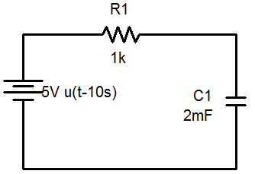
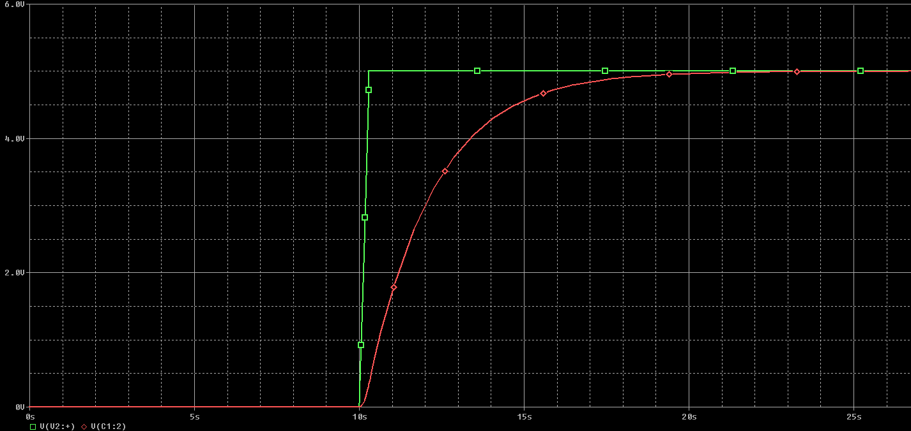
V_{C1}(t) = 5V[1-e^{–(t-10s)/τ}]
τ = RC = 2s
V_{C1}(t) = 5V[1-e^{–(t-10s)/2s}]

Slide 82
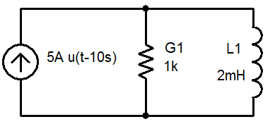
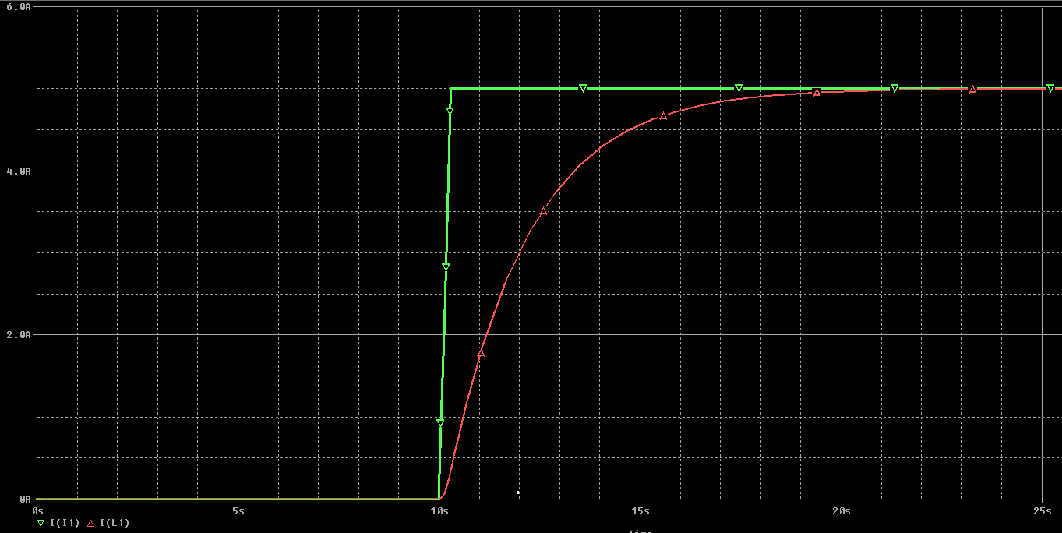
I_{L1}(t) = 5A[1-e^{–(t-10s)/τ}]
τ = L1/R1 = L1G1
I_{L1}(t) = 5A[1-e^{–(t-10s)/2s}]

Slide 83
To Construct Dual Circuits
Place a node at the center of each mesh of the circuit.
Place a reference node (ground) outside of the circuit.
Draw lines between nodes such that each line crosses an element.
Replace the element by its dual pair.
Determine the polarity of the voltage source and direction of the current source.
A voltage source that produces a positive mesh current has as its dual a current source that forces current to flow from the reference ground to the node associated with that mesh.

Slide 84
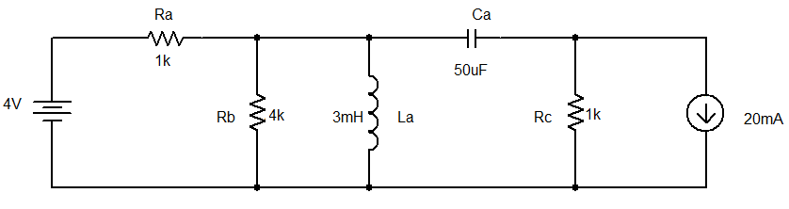
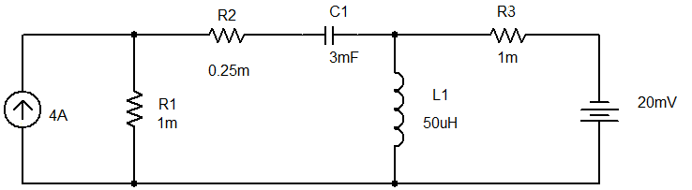
Example 05
Circuit:
Its dual:

Slide 85
Summary
The principle of duality means that the solution to one circuit can be applied to multiple other circuits that can be described using the same set of equations in which the variables have been interchanged.

